Slide 1





Play Together
Motive
Android 기반 농구 커뮤니티 어플리케이션
Architecture
Demo
Q & A
경상대학교
이상현

Slide 2

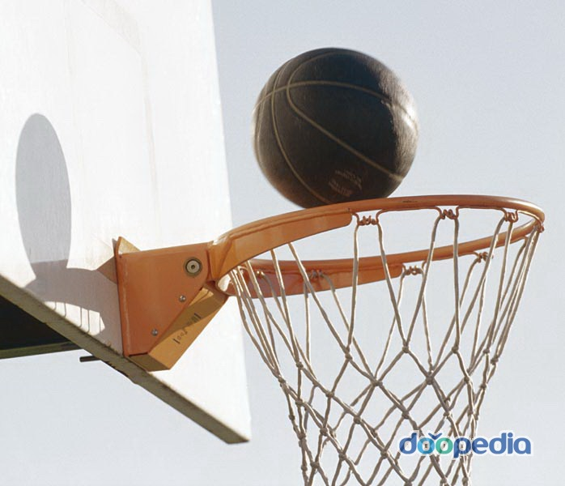


Motive

Slide 3
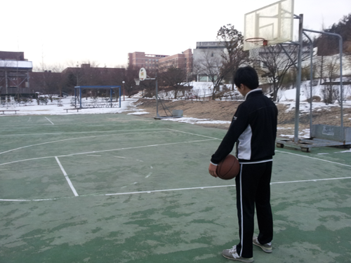
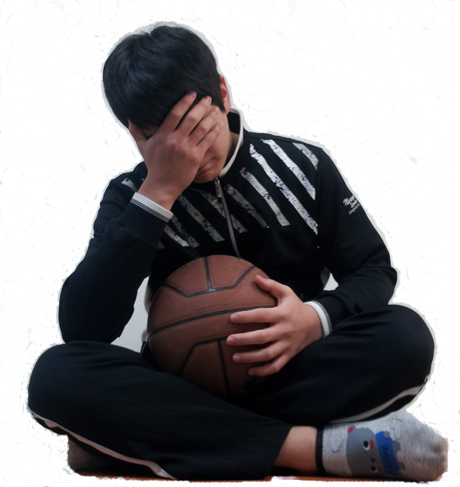
Motive

Slide 4


Motive

Slide 5

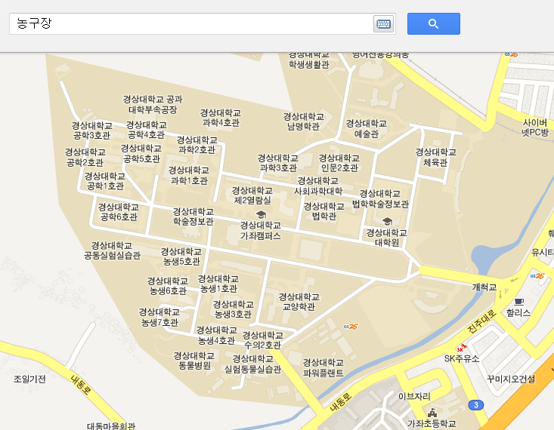

Motive

Slide 6
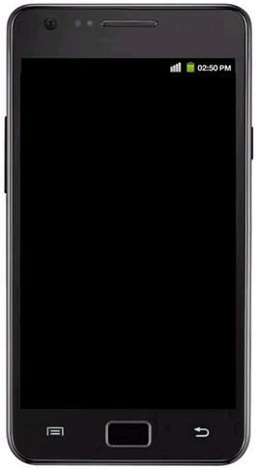



Motive
HOW???
스마트
농구 커뮤니티
어플리케이션

Slide 7

Architecture -System-
CLIENT
SERVER
Log In
Member Register
DATABASE
Data Access Object
Court
View
Court
Board
Play Together
PTServer
mysql
Google Map API
Http Library
MyBatis
Android OS
Apache Tomcat

Slide 8
Architecture -Client-
Input Data
User Input Data
Activity
Android
Main Thread
Transceiver Thread
.execute
Transceiver Thread
Http Library
SERVER

Slide 9
Architecture -Server-
SERVER
SERVICE
CASE
D.A.O
CLIENT
Member :
Manager
Http Library
request
Login :
JSON
DATABASE
JSON Parser
response
Court :
Mapper
Board :
MyBatis
Android
mysql

Slide 10
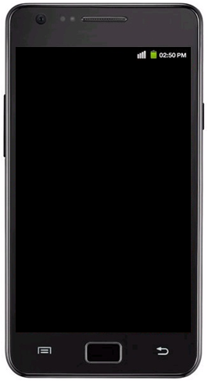



Demo
Demo
Demo

Slide 11

Q & A

Slide 12

감사합니다

